Slide 1
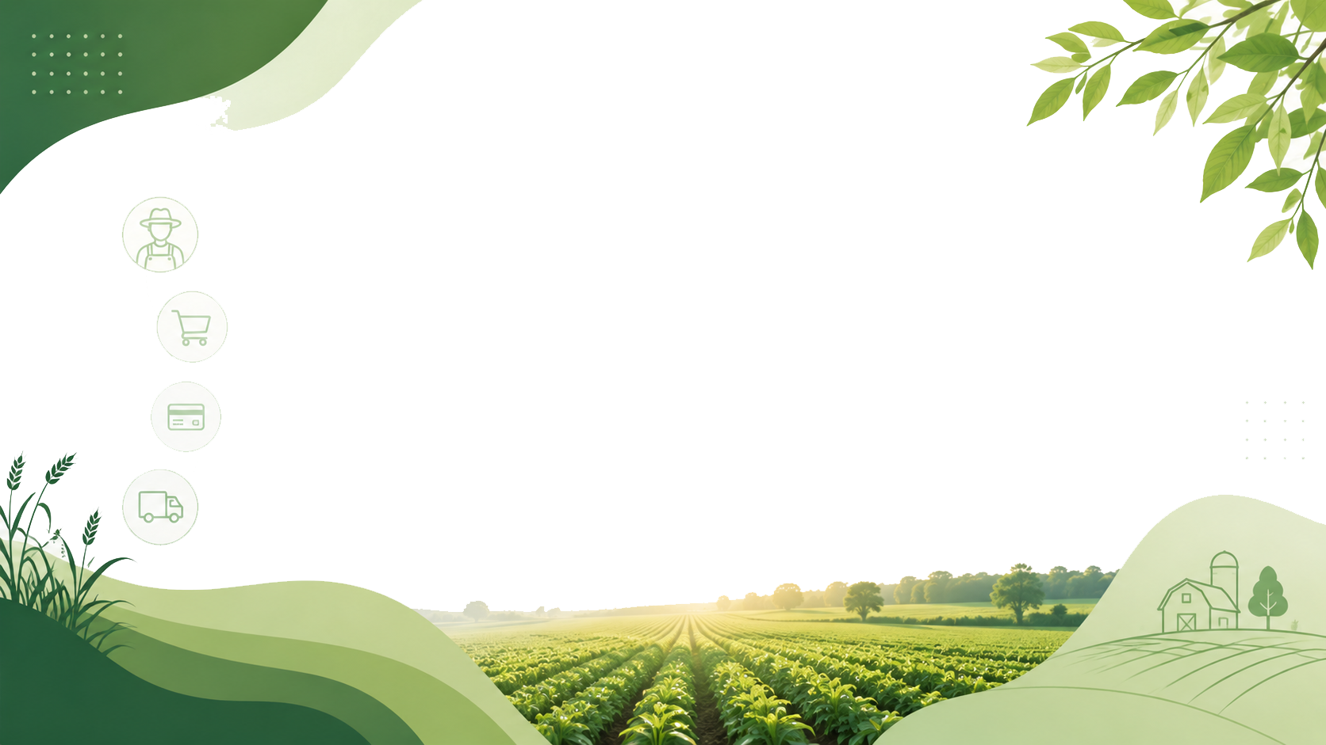

Agricultural Products Direct to Customers: An Online Farm-to-Consumer Marketing System
PRESENTED BY
YADDALA KUSHAL KUMAR
PULLAREDDIGARI.KIRAN
Guide: Prof. DR.Vijayaragavan P and DR. ARUNA

Slide 2

Introduction
Agriculture is the backbone of the economy.Farmers often depend on intermediaries to sell products.Middlemen reduce farmers' profits.Online platforms can connect farmers directly with consumers.This project provides a digital marketplace for agricultural products

Slide 3
Problem Statement
Farmers receive low prices for their produce.
Multiple intermediaries increase product costs.
Lack of direct communication between farmers and consumers.
Limited market access for small-scale farmers.

Slide 4
Objectives
Enable direct sales from farmers to customers.
Increase farmers' profits.
Provide fresh products to consumers.
Reduce dependency on middlemen.
Ensure transparent pricing..

Slide 5
Scope of the Project
Online product listing.
Customer registration and login.
Product search and filtering.
Order management.
Payment integration.
Delivery tracking.

Slide 6
Proposed Solution / Methodology
Web-basedfarm-to-consumer platform.
Farmers upload product details.
Customers browse and purchase products online.
Secure payment and order tracking.
Direct communication between farmers and buyers.

Slide 7
Literature Survey / Existing System
Title | Author(s) | Short Key Finding
Digital Farm Link: A Trust-Centric Marketplace Integrating AI, Blockchain, IoT, and Federated Learn | Wagh et al. | Uses AI, Blockchain, and IoT to create a secure and transparent farmer-to-consumer marketplace.
Connecting Farms and Consumers: A Feasibility Study of a Regional Food Platform | Kouva, R. | Shows that digital food platforms improve direct sales and local market access.
Strategic Marketing Framework for Farmer Organizations’ Agri-Food Products | Sena, C.J. | Highlights the importance of digital marketing and branding for increasing agricultural product sales.
Transforming India’s Dairy Landscape: The Rise of Startups and Pathways to Sustainable Growth | Kumar, V., Aiswarya, S., Gururaj, M., & Saxena, N. | Explains how agri-tech startups help farmers improve market reach and sustainability.

Slide 8
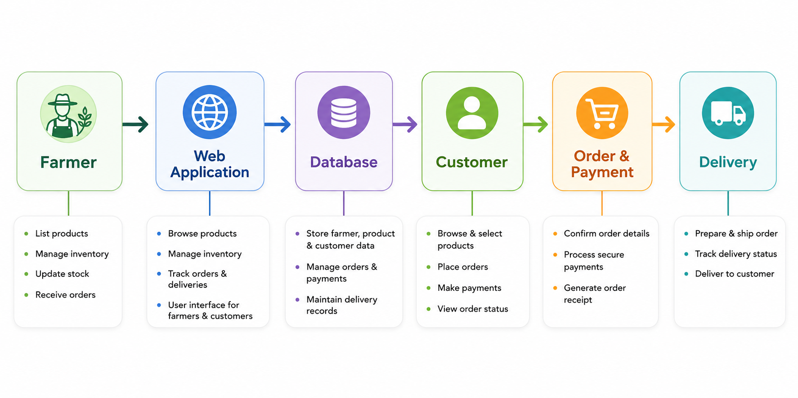
System Architecture

Slide 9
Tools and Technologies
Software
ANTIGRAVITY – Code development and editing.
MySQL – Database management.
Git & GitHub – Version control and project management.
Frontend Technologies
HTML – Structure of web pages.
CSS – Styling and user interface design.
JavaScript – Interactive functionality.
Backend Technology
Python (Django/Flask) or PHP – Server-side development.
REST APIs – Data communication between frontend and backend.

Slide 10
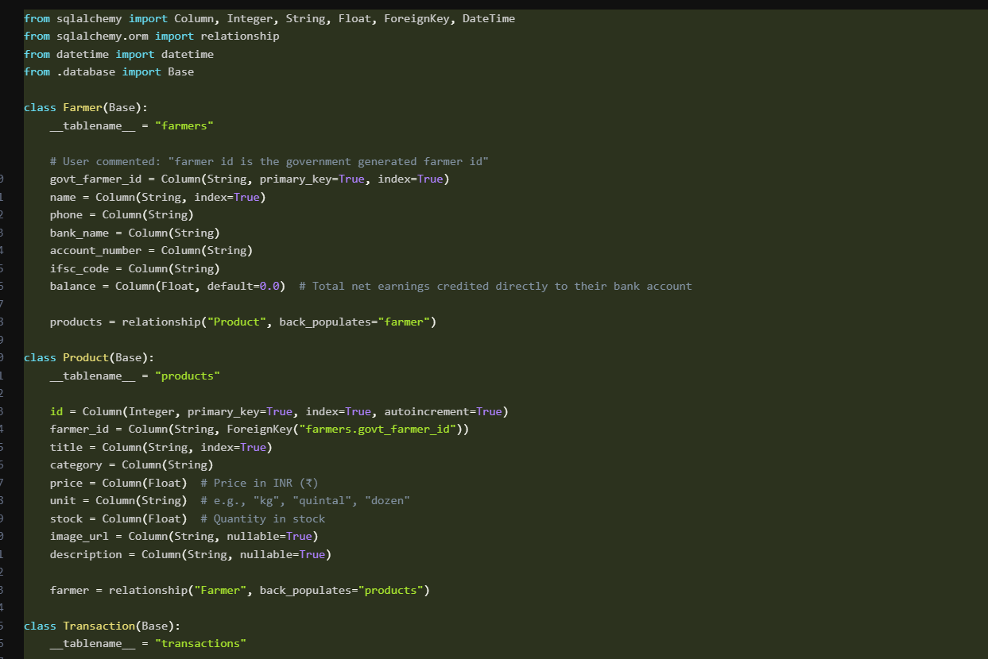
CODE

Slide 11
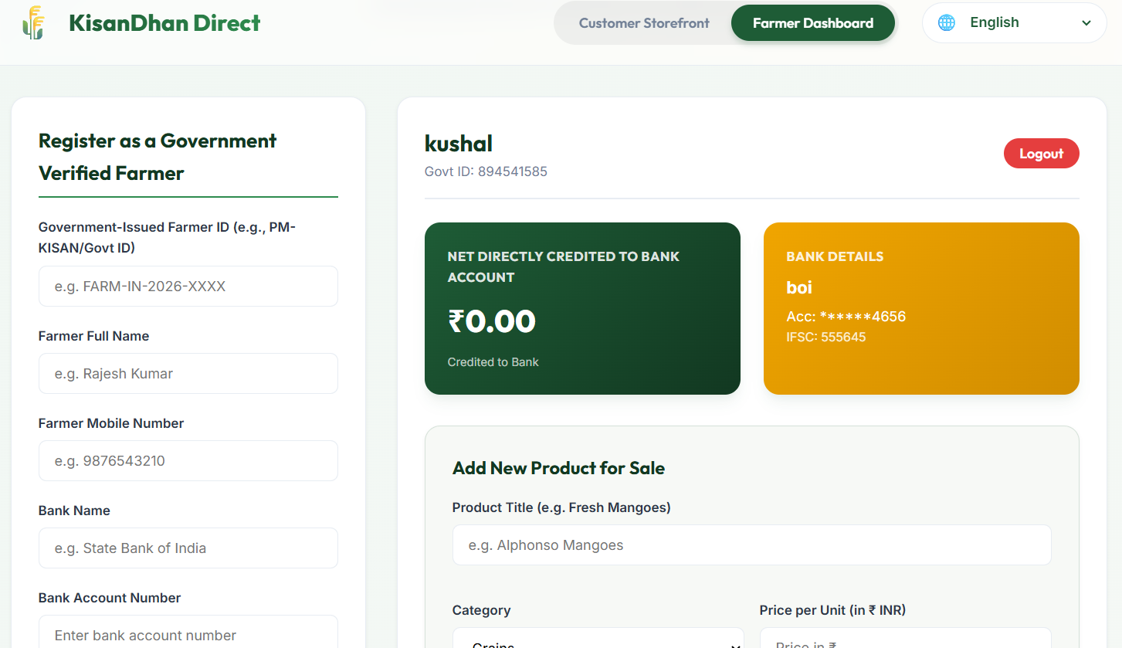
OUTPUT

Slide 12
Expected Outcome
Farmers can sell agricultural products directly to customers without intermediaries.
Customers can easily browse and purchase fresh farm products online. Farmers receive better profits through fair pricing.
Customers get quality products at lower costs. The system provides a simple and user-friendly interface for product management and ordering.
Online ordering and payment processes become more efficient and transparent.
Increased market reach for farmers beyond local markets. Improved customer satisfaction through timely delivery of fresh products

Slide 13
References & Acknowledgements
Wagh, C., Bavane, H., Hirade, M., Adsul, A., Bele, D. and Ghodake, S., Digital Farm Link: A Trust-Centric Marketplace Integrating AI, Blockchain, IoT, and Federated Learning for Transparent Farmer-to-Consumer Trade. communities, 11, p.12.
Kouva, R., 2026. Connecting Farms and Consumers: A Feasibility Study of a Regional Food Platform.
Sena, C.J., 2026. Strategic Marketing Framework for Farmer Organizations’ Agri-Food Products. Journal of Interdisciplinary Perspectives, 4(5), pp.197-214.
Kumar, V., Aiswarya, S., Gururaj, M. and Saxena, N., 2025. Transforming India’s dairy landscape: The rise of startups and pathways to sustainable growth. Indian Journal of Animal Health, 64(2), pp.243-254.

Slide 14
THANK YOU

